Slide 1
Decomposition

Slide 2

Decomposition
Simply put, decomposition is a general problem solving process where we break down a problem into its constituent parts. You probably do decomposition all the time in your day to day life without even thinking about it!
Have you ever tried baking a cake or cooking a recipe before? If the answer is yes, then you have used decomposition. Cooking and baking are complex problems, so we break them down into step by step pieces in order to help us out. Instead of just thinking about *baking a cake*, we think in steps like cracking 2 eggs, measuring the flour, and preheating the oven. When we do this, we are decomposing baking into consumable chunks. Easy, right?

Slide 3
Learning Objectives
Define decomposition
Decompose a simple problem into appropriate components
Differentiate between a physical and a logical decomposition
Evaluate a decomposition with respect to its depth and logical cohesion

Slide 4
Decomposition
Decomposition is a general problem solving tactic in which a problem is broken down into its constituent components, each of which is now easier to solve.

Slide 5
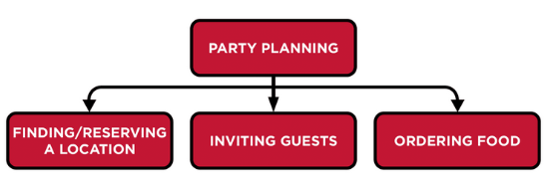
How Decomposition Works
For example, if you are planning your graduation party, you might decompose this into these components:
Finding and reserving a location
Inviting guests
Ordering food
Note that this decomposition does not indicate the order in which these have to be done. (An algorithm would add that information.) The order in which we have written these may seem to imply an order. Sometimes it is useful to outline decompositions in a form called hierarchy. Here is an example below:

Slide 6
What Criteria Makes a Decomposition Appropriate?
1. Sufficiently Detailed
A helpful criteria in answering this question is to ask whether the individual components on the bottom level represent problems that we are now confident that we can solve. In this case, if we are planning a simple party for a few friends or for our family, it is probably fine. However, suppose that we need to plan for a wedding reception. In that case, we may need to add more detail.
The point is not that one of these is the correct way and the other incorrect. The level of detail depends on the context. To repeat, a useful criterion is to determine if the bottom level of components are those that we are comfortable solving. If not, we decompose further.
The bottom level of components are those that we are comfortable solving.

Slide 7
Decompose Wedding Planning
Wedding planning
Location planning
  Determine general location (near her family, or his, or ??)
  Making reservation
  Reserving chairs and tables
  Reserving plates, serving dishes, eating utensils, etc.
Invitations
  Determining the total number of guests
  Creating the bride’s list
  Creating the groom’s list
  Paring the list down to the appropriate number
Food
  Determining the menu
  Ordering food
  Ordering wine

Slide 8
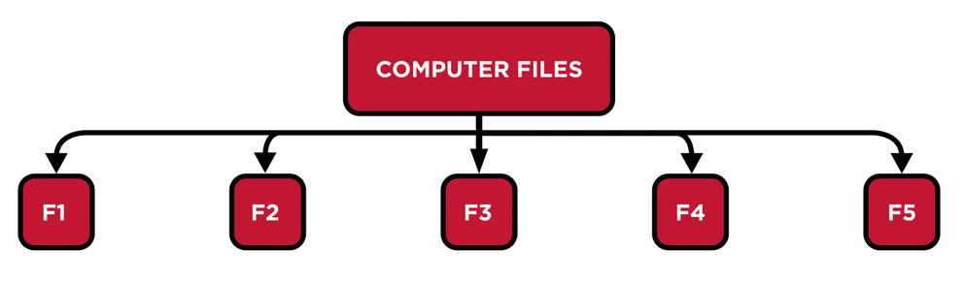
What Criteria Makes a Decomposition Appropriate?
2. Decomposing to Organize
Decomposing into a hierarchy is a useful way of organizing our thinking about a problem or situation. Consider the problem of finding files on your computer. If you have a few files, this is not a problem. You don’t need to put them into “folders”. However, as you accumulate more and more files, a hierarchical organization will make finding files much easier. For example, suppose that you have 100 files on your computer including files with homework assignments for school, files about your work with a charity (lists of members, flyers about charitable events), and files about your family (pictures, etc.) If these are not organized into folders, finding the one you want will involve looking at the names of each file. If your files are not named well, you may need to open those files. We would describe this as a flat organization. If we pictured this, it would like something like this:

Slide 9
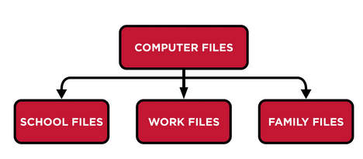
Decomposing Files
Contrast this with the situation in which you have three folders in which these files are organized:
School files
Work files
Family files

Slide 10
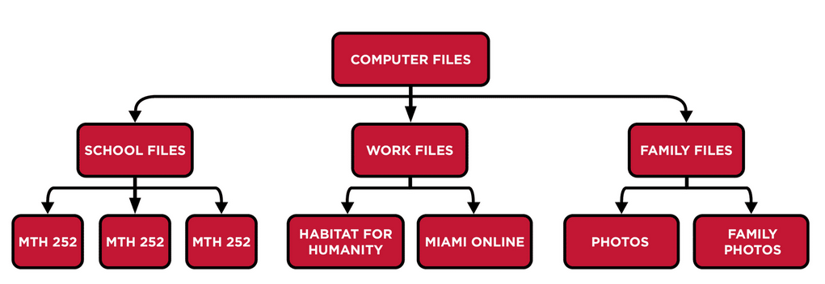
Add More Levels
Finding the appropriate is considerably easier. However, as you accumulate more files, it may be useful to add more levels to the hierarchy, that is, to add additional folders inside these folders.
School files
  MTH 252
  ECO 201
  ENG 111
Work files
  Habitat for Humanity
  Interalliance
Family files
  Photos
  Important documents

Slide 11
Logical Hierarchy Structure
The use of a logical hierarchy structure can make finding files much easier. Is this hierarchy sufficient? You may decide that it is still too difficult to find files. For example, you may want to retain files from your past classes but still have quick access to current classes. And you may have so many pictures that you would find it useful to organize those by the family member or by the year when they were taken. So, another refinement of this decomposition could be this one:
School files
    First-year courses
    MTH 252
    ECO 201
    ENG 111
    Second-year courses
    PHY 191
    PSY 252
    Third-year courses
    ENG 313
    HST 345
Work files
    Habitat for Humanity
    Interalliance
Family files
    Photos
      2022
      2021
      2020
      2015-2019
    Important documents
Of course, it is possible to decompose our problem into components that are unnecessarily too small or to extend our hierarchy too deep. For example, in the wedding planning example, it may be helpful to break the location planning down to the level of each table (that is, who is to sit at each table at the reception) but to go to the level of which fork is assigned to Uncle George is ridiculous.
So, we now have two criteria to judge the quality of a decomposition:
Are the bottom level components at a level that we are confident we can solve?
Have we used a hierarchy in an effective way?

Slide 12
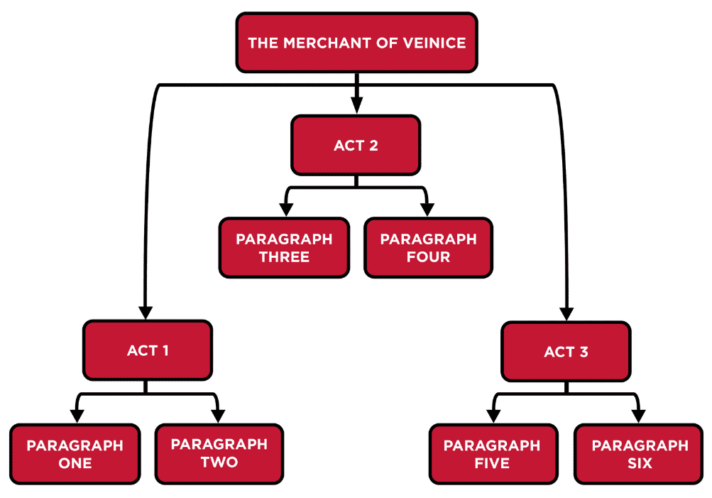
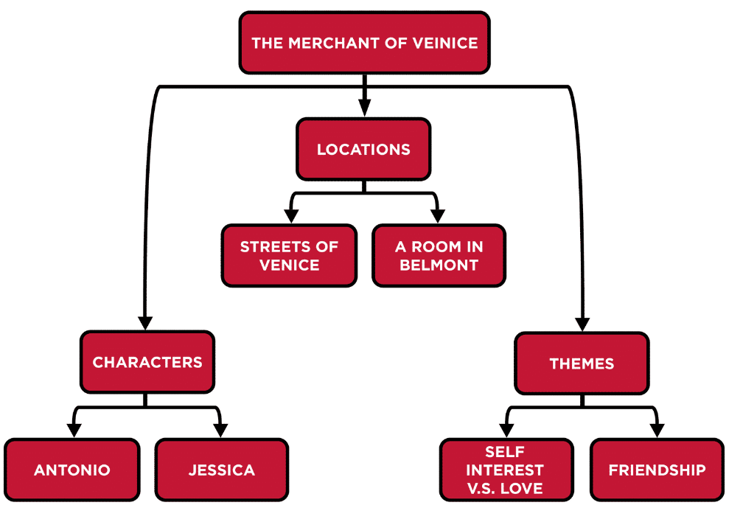
What Criteria Makes a Decomposition Appropriate?
There is one more criterion to consider. That is the difference between a logical and a physical decomposition. Consider the following two decompositions that students might use in organizing an essay about a particular Shakespeare play.
We would describe the first as a physical decomposition of this play. It is accurate, the components at the bottom level are at a level that we can understand, and this has a hierarchy that has an appropriate depth and organization. However, the problem of writing this essay has not been broken down into logically coherent pieces. How does this help the student organize what he/she wants to say about this play? Contrast that first one with the second one that we would describe as a logical decomposition. When the student begins to write the essay, each box gives a clear idea of the point of that section of the essay.

Slide 13
Conclusion
Thus, our criteria for judging the quality of a decomposition are these:
Are the bottom level components at a level that we are confident we can solve?
Have we used a hierarchy in an effective way?
Are the components logical rather than physical in nature?

Slide 14
Knowledge Check - Question 1
What is the definition of decomposition?
Decomposition is a general problem solving tactic in which a problem is broken down into its constituent components, each of which is now easier to solve.
Decomposition is taking computer applications apart in order to understand them better.
Decomposition is the slow process of computers becoming slower due to advances in technology.

Slide 15
Knowledge Check - Question 2
Select all the appropriate components of the decomposition of baking a cake
Locking the front door
Measuring the flour
Washing your hands
Preheating the oven to 350 degrees

Slide 16
Knowledge Check - Question 3
What makes decomposition logical?
A decomposition is logical when it has an appropriate depth
A decomposition is logical when the problem has been broken into coherent pieces that fulfill the purpose of the decomposition
A decomposition is logical when it has more than 3 levels

