Slide 1
Data and Privacy

Slide 2
Ethics in computing
Ethics is the study of right and wrong, often applied to a particular field
Laws provide penalties for some actions, but we need to think about questions of right and wrong whether or not a law is applicable
Computing offers a special challenge because laws cannot always keep up with rapid changes in technology
Ethical considerations around computing raise many interesting issues:
  Vast quantities of data can be stored indefinitely
  Computers can process this data quickly and make inferences
  Computers can make perfect copies of existing data
  Information can be disseminated instantly across the world through the Internet
  Computers are being used to make important decisions

Slide 3
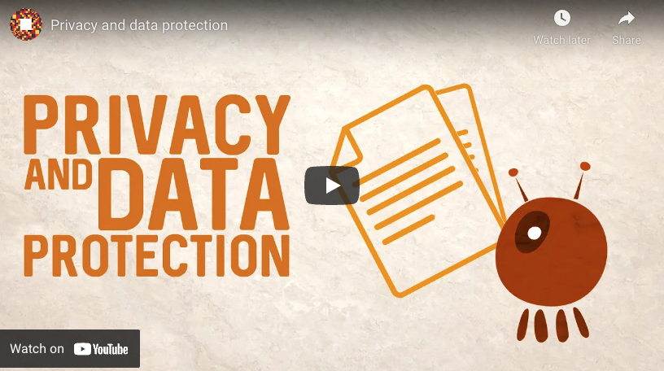
Topics
There are many different ways to think about data, how we use it, and what privacy means
A few important considerations:
  What we do with other people’s data
  What companies do with our data
  How data is used to shape the world

Slide 4
Ethics Vs. Laws
Ethics
Ethics is the study of right and wrong, often applied to a particular field, like ethics in computing for example. It is a branch of moral philosophy that helps to guide the conduct of people during their day-to-day lives. Furthermore, failure to adhere to a set of ethics is not punishable, although the people around you may not like it!
Laws
Laws, while they may be informed by ethics, are not a set of guidelines. Laws are a concrete set of rules and regulations made by governments meant to keep people in line. Furthermore, adherence to laws is not optional, and failure to do so is punishable.
The key difference is that laws have to be codified by the government before they take affect and that takes time. This means that often times ethics outpace laws, especially in a rapidly changing field like computing, leaving a discrepancy between what is legal and what is ethical.
Can you think of something that is legal, but not ethical?
Computing, specifically, raises many ethical concerns, due to the fact that computing is a powerful new tool that allows us to do many things that were simply not possible before its invention. Here are some ethical considerations in computing:
  Vast quantities of data can be stored indefinitely
  Computers can process this data quickly and make inferences
  Computers can make perfect copies of existing data
  Information can be disseminated instantly across the world through the Internet
  Computers are being used to make important decisions
Take some time and reflect on how these considerations could cause concerns.

Slide 5
Other People's Data

Slide 6
What we do with other people’s data
Whenever you take a photograph, write an essay, or record yourself playing piano, you have created data that you own
Most people create lots of data every day
Although a sea of data is available, we should not use other people's data without permission

Slide 7
Copyright
Copyright is a set of evolving laws that protect the expression of an idea
It emerged to encourage the exchange of ideas while protecting the authors
You own the copyright on anything you create, simply by virtue of creating it
  But you have to register the copyright in order to claim damages in court
In the U.S. a copyright lasts:
  For 70 years after the death of the author if a person copyrighted it
  95 years after publication if a corporation copyrighted it

Slide 8
Piracy
Copyright infringement is also called piracy
Data and information are valuable
If you use data inappropriately or without permission, there can be consequences
If you publicly post data that belongs to someone else, a court can order you to take it down
If the owner of the data feels that your use of their data cost them money, they can sue you
There are laws that can make it a crime to use data without permission for monetary gain

Slide 9
Streaming
In the early 2000s, file sharing tools like Napster allowed many people to share music and movie files illegally
BitTorrent, a tool using a decentralized, peer-to-peer approach, allowed another wave of piracy after Napster and other tools were shut down
Although similar tools still exist, streaming video and audio has replaced much of the desire to share files illegally
Is sharing paid accounts with your friends on sites like Netflix, Hulu, Spotify, and Pandora illegal?
  In most cases, it violates the terms of service
  Whether or not it's criminal is still being worked out

Slide 10
Creative Commons
Creative Commons is an organization founded in 2001
It believes that many people want to share data but copyright makes it difficult to get permission
Creative Commons provides licenses that anyone can use to mark data they created as freely usable by others
Depending on the license, Creative Commons lets people specify:
  Whether their work can be changed or remixed
  Whether their work can be used for commercial purposes
Commercial sites like Flickr and Google allow you to search for Creative Commons licensed images
Many sites are dedicated to Creative Commons content
  Sounds: https://freesound.org/
  Music: https://freemusicarchive.org/

Slide 11
Plagiarism
In an academic setting, a common problem is representing data that belongs to someone else as data you created
This misuse of data is often called plagiarism
In many but not all cases, data can be used for educational purposes, even without getting prior permission, as long as credit is given to the creator or owner
Possible consequences of misusing data at school:
  Lowered grades on assignments
  Suspension or expulsion
  Loss of a degree if the plagiarism is discovered after the degree is granted

Slide 12
Wikipedia
Although Wikipedia.org is only a single, free website, it deserves special attention because of its popularity
When working on academic projects, it's inappropriate to site Wikipedia as a source
The problem is that Wikipedia is created by a collection of anonymous volunteers who cannot be credited and have no accountability
However, Wikipedia pages usually list references used to develop each page, and these references are often excellent places to begin further research

Slide 13
What Companies Do with Our Data

Slide 14
Our Data
We create data intentionally, but we also generate data unintentionally as a consequence of visiting websites and using apps
Companies use that data
  To target advertisements at us
  By selling it to other companies, usually for marketing purposes
  To change how their products work, often to get users to use a product more
Smartphones can add precise location information to this data
Andrew Lewis famously posted:
  If you are not paying for it, you're not the customer; you're the product being sold.

Slide 15
Terms of service
It seems invasive for a company to build up an elaborate picture of what we like, who are friends are, and how we spend our time
But we usually give permission for companies to do just that
Websites and apps have terms of service or end user license agreements (EULA)
Often merely by using a website or app, you are agreeing to its terms of service

Slide 16
What can you do about your data privacy?
Options are limited
  Services like Facebook and Google are so widely used that it's hard to avoid them
  It's difficult to navigate modern society without a smartphone
Many apps and services have data privacy settings that allow you to reduce the amount of information you share
In the US, laws restrict the amount of information the government can collect about you, but corporations have few restrictions
We may need laws that look at digital privacy more closely

Slide 17
How Data Shapes the World

Slide 18
Data in the World
Data itself is neither positive nor negative
Although it can be alarming that Google tracks your movements, the same technology allows it to monitor traffic jams and suggest better routes
Machine learning is a technology that uses data to model the world, improving as it processes more data
Machine learning and other algorithms are being used for more and more important decisions
  Screening resumes for job applicants
  Recognizing faces for security purposes
  Deciding who can borrow money
  Predicting a person's future risk for committing crimes

Slide 19
Bias in machine learning
Getting a numerical score from a computer feels scientific, but machine learning can be subject to biases
Since these algorithms are trained on data, biased input data will lead to biased results
Bias can result from:
  Training data that only represents a portion of the population
  Training an algorithm to mimic historical decisions, which may have been sexist, racist, or subject to other biases
  Errors in programming or mathematics

Slide 20
Examples of bias
Some face recognition software was trained mostly on white men
  Its performance can be much worse on women and people of color
  2018 research at MIT and Microsoft found error rates as high as 34.7% for dark-skinned females compared to 0.3% for light-skinned males
Job screening software
  A 2018 report by Reuters described an Amazon resume screening tool that preferred words like "executed" and "captured" that were used by men more than women
Predicting future risk of committing crimes
  A 2016 ProPublica report showed that high numbers of African American defendants were labeled high risk but didn't re-offend while high numbers of white defendants were labeled low risk yet did re-offend
Deciding who can borrow money
  2019 research from Berkeley finds that algorithmic systems charge borrowers of color higher mortgage rates and are more likely to reject their mortgage applications

Slide 21
Addressing algorithmic bias
As with privacy, social and legal changes may be necessary
Remember that decisions made by computers are really just decisions made by the people who coded or trained the algorithms
Biased inputs lead to biased outputs
We should demand more transparency about how such important algorithms work, since their details are often secret
Advocating for diversity within computer science may help to broaden the perspectives in the field

Slide 22
Activities

Slide 23
Activity 1
Think of one of your favorite movies, books, or songs
When was it created, and who holds the copyright for it?
When will it enter the public domain and no longer be protected by copyright?

Slide 24
Activity 2
If you use a streaming service like Netflix, Hulu, Spotify, or Pandora, look up the terms of service
Are there any restrictions on sharing the account information with other people?
What repercussions could you face if you violate the terms of service?

Slide 25
Activity 3
Pick a topic you're interested in, whether from history, popular culture, science, or anything else
Visit the Wikipedia page for that topic, and look through the references at the bottom
If possible:
  Borrow a book from the library that's listed in the references
  Find the original source of some information given on the page

Slide 26
Activity 4
Read through the Google Privacy Policy
What data does Google collect about you?
Was there anything that Google collects that you were surprised by?
Consider reading similar privacy policies at other sites you use frequently
  Note that some use legalistic language that can be difficult to read

Slide 27
Activity 5
If you use any Google services, consider doing their Privacy Checkup
This tool allows you some controls over the information that Google keeps
  How long before your web activity will be deleted
  How long before your YouTube history is deleted
  What happens to your data if you stop using your account
If you use social media services like Facebook, consider exploring their privacy settings

Slide 28
Activity 6
Have you done any of the following activities recently?
  Bought a house or applied for a mortgage
  Applied for a credit card
  Applied for a small business loan
  Applied for a job
If you have, try to look through the associated documentation or relevant journalism to determine if an algorithm may have played a part in the decision-making process
Whether or not an algorithm was involved, list any potential sources of bias for the decision in your case

