Slide 1
Data Representation and Cryptography
For the Math Content Area for Middle Childhood

Slide 2
Data
All data is stored inside a computer as sequences of 1s and 0s
Numbers can be represented in binary, which is base 2 instead of the usual base 10 we use
But what about words?

Slide 3
Characters
To be able to store words, we have to represent the individual characters that make them up
Characters can be:
  Alphabetic: ABCDEFGHIJKLMNOPQRSTUVWXYZ
  Numerical digits: 0123456789
  Punctuation: ,.?:;!"'
  Lots of others: {}()+-*/%$

Slide 4
Representing Characters - Encoding
Since we have a good system for storing numbers inside a computer, we represent each character with a number
One way to do this would be to represent each letter of the alphabet with a number from 1-26:
Letter | A | B | C | D | E | F | G | H | I | J | K | L | M
Number | 1 | 2 | 3 | 4 | 5 | 6 | 7 | 8 | 9 | 10 | 11 | 12 | 13
Letter | N | O | P | Q | R | S | T | U | V | W | X | Y | Z
Number | 14 | 15 | 16 | 17 | 18 | 19 | 20 | 21 | 22 | 23 | 24 | 25 | 26

Slide 5
More complexity
What if we wanted to represent uppercase and lowercase letters?
We need unique numbers for every character!
We could keep the numbering going after 26 …
Letter | A | B | C | D | E | F | G | H | I | J | K | L | M
Number | 1 | 2 | 3 | 4 | 5 | 6 | 7 | 8 | 9 | 10 | 11 | 12 | 13
Letter | N | O | P | Q | R | S | T | U | V | W | X | Y | Z
Number | 14 | 15 | 16 | 17 | 18 | 19 | 20 | 21 | 22 | 23 | 24 | 25 | 26
Letter | a | b | c | d | e | f | g | h | i | j | k | l | m
Number | 27 | 28 | 29 | 30 | 31 | 32 | 33 | 34 | 35 | 36 | 37 | 38 | 39
Letter | n | o | p | q | r | s | t | u | v | w | x | y | z
Number | 40 | 41 | 42 | 43 | 44 | 45 | 46 | 47 | 48 | 49 | 50 | 51 | 52

Slide 6
How big does the table need to be?
In addition to uppercase and lowercase letters, we need to represent numerical digits, punctuation, and other special characters
But that's all a very English-centric way of looking at the problem
What about:
  Accented characters used in many European languages: ÀÁÂÃÄÅ
  The Greek alphabet: Ελληνικό αλφάβητο
  The Arabic alphabet: أبجدية عربية
  The Devanagari script used for many Indian languages: देवनागरी
  Tens of thousands of Chinese and Japanese characters: 漢字
  And many other languages!

Slide 7
Unicode to the rescue!
The Unicode Standard is the result of lots of people working together to find a number for every characters we want to use
You can think of it as a giant table for all the world's characters
Right now, the table has 144,697 characters in 159 different alphabets
The Unicode Consortium keeps adding new characters and symbols, with a new version of Unicode out about every year

Slide 8
The real numbers of the alphabet
The Unicode Standard does not use the numbers 1-26 for the letters A through Z
These letters got their numbers in an earlier standard that made some odd choices
The uppercase letters A through Z map to the numbers 65-90, and the lowercase letters a through z map to the numbers 97-122
Letter | A | B | C | D | E | F | G | H | I | J | K | L | M
Number | 65 | 66 | 67 | 68 | 69 | 70 | 71 | 72 | 73 | 74 | 75 | 76 | 77
Letter | N | O | P | Q | R | S | T | U | V | W | X | Y | Z
Number | 78 | 79 | 80 | 81 | 82 | 83 | 84 | 85 | 86 | 87 | 88 | 89 | 90

Slide 9
Cryptography
Cryptography means "secret writing"
It's the science of writing messages so that it's difficult to determine what they mean, unless you know the secret
Modern cryptography is used to make the Internet much more secure
When someone buys something online, the messages they send with their name or credit card number are encrypted so that only the computer they're talking to can read them
That computer decrypts the message, making it readable again

Slide 10
Using math for cryptography
Once we've encoded letters as numbers, we can use math to turn transform those numbers
For example, we could add, subtract, or multiply the numbers by special numbers that only we know
These special numbers are called the key, the information used to encrypt or decrypt a message

Slide 11
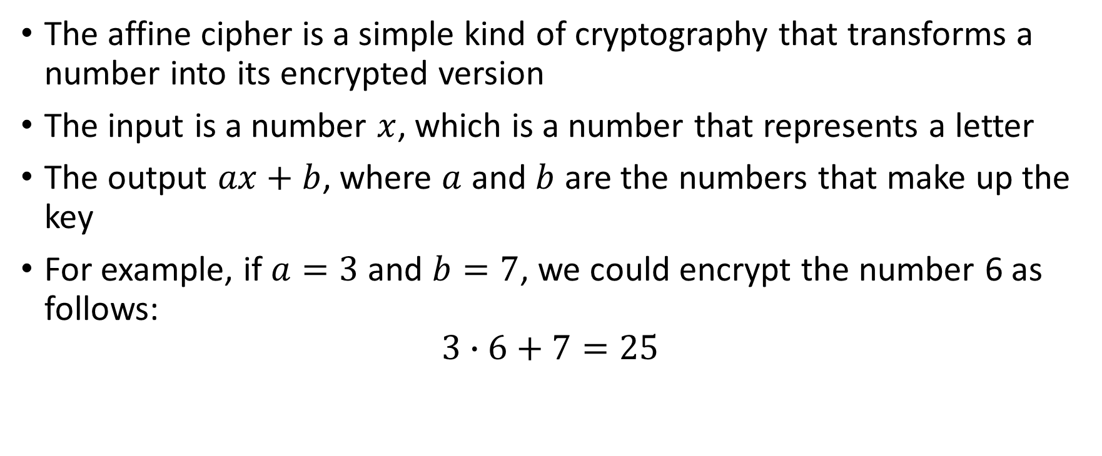
Affine cipher
The affine cipher is a simple kind of cryptography that transforms a number into its encrypted version
The input is a number $x$, which is a number that represents a letter
The output $ax+b$, where $a$ and $b$ are the numbers that make up the key
For example, if $a=3$ and $b=7$, we could encrypt the number 6 as follows:
$$3∙6+7=25$$

Slide 12
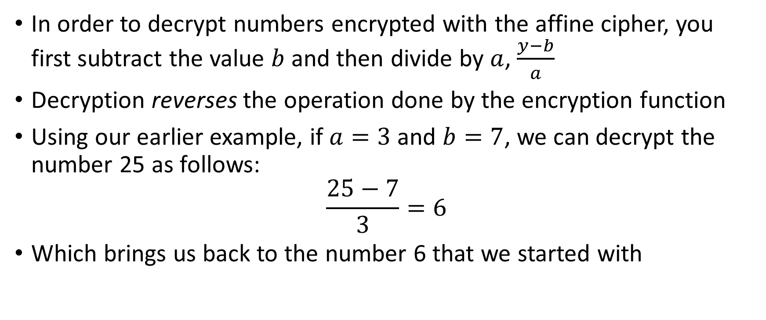
Decryption with the Affine Cipher
In order to decrypt numbers encrypted with the affine cipher, you first subtract the value $b$ and then divide by $a$, $\frac{y−b}{a}$
Decryption reverses the operation done by the encryption function
Using our earlier example, if $a=3$ and $b=7$, we can decrypt the number 25 as follows:
$$\frac{25−7}{3}=6$$
Which brings us back to the number 6 that we started with

Slide 13
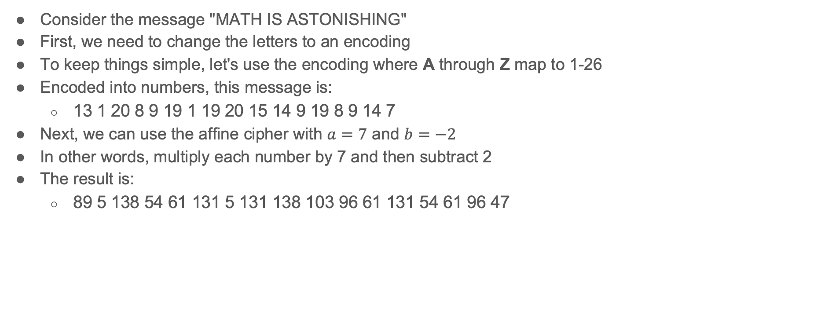
Affine Cipher Encryption Example 1
Consider the message "MATH IS ASTONISHING"
First, we need to change the letters to an encoding
To keep things simple, let's use the encoding where A through Z map to 1-26
Encoded into numbers, this message is:
  13 1 20 8 9 19 1 19 20 15 14 9 19 8 9 14 7
Next, we can use the affine cipher with $a=7$ and $b=−2$
In other words, multiply each number by 7 and then subtract 2
The result is:
  89 5 138 54 61 131 5 131 138 103 96 61 131 54 61 96 47

Slide 14
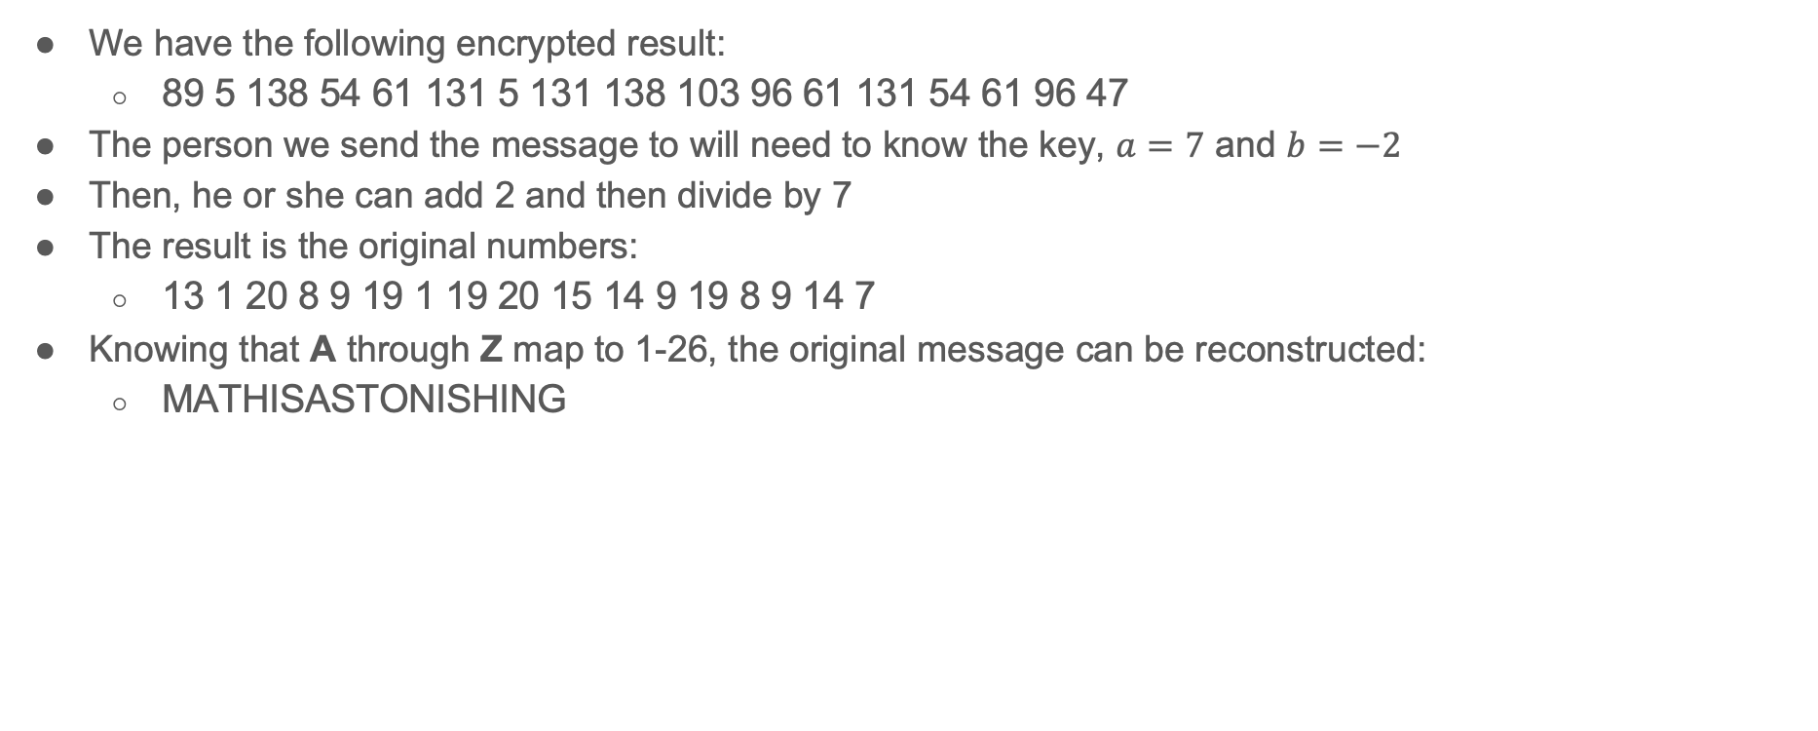
Affine Cipher Encryption Example 2
We have the following encrypted result:
  89 5 138 54 61 131 5 131 138 103 96 61 131 54 61 96 47
The person we send the message to will need to know the key, $a=7$ and $b=−2$
Then, he or she can add 2 and then divide by 7
The result is the original numbers:
  13 1 20 8 9 19 1 19 20 15 14 9 19 8 9 14 7
Knowing that A through Z map to 1-26, the original message can be reconstructed:
  MATHISASTONISHING

Slide 15
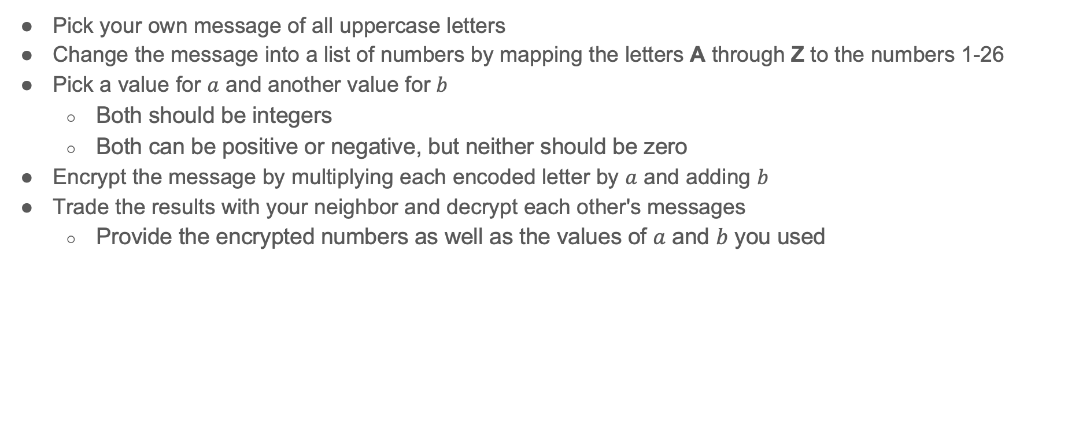
Affine Cipher Exercise
Pick your own message of all uppercase letters
Change the message into a list of numbers by mapping the letters A through Z to the numbers 1-26
Pick a value for $a$ and another value for $b$
  Both should be integers
  Both can be positive or negative, but neither should be zero
Encrypt the message by multiplying each encoded letter by $a$ and adding $b$
Trade the results with your neighbor and decrypt each other's messages
  Provide the encrypted numbers as well as the values of $a$ and $b$ you used

Slide 16
Deeper Practice
As you know, the numbers that A through Z are encoded to on almost all modern computers are 65-90, not 1-26
Repeat the exercise from the previous slide but encode the letters to 65-90
The numbers will be larger, so a calculator might be helpful

Slide 17
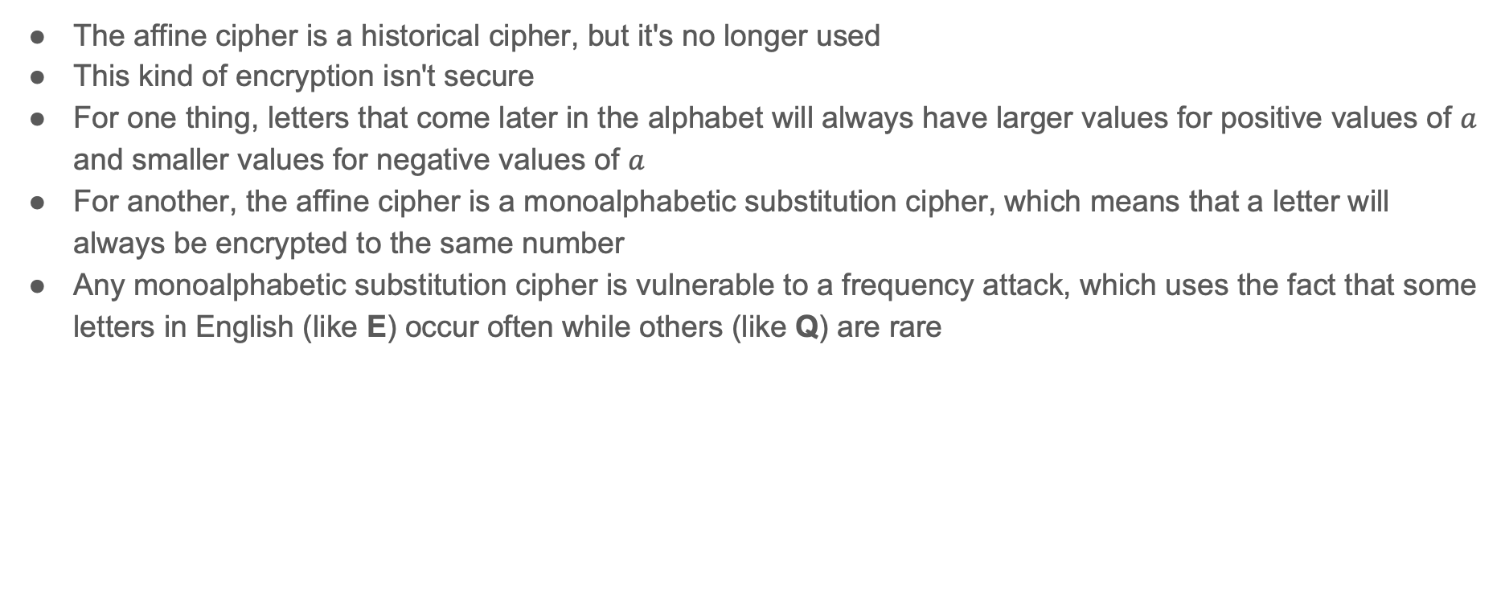
Security
The affine cipher is a historical cipher, but it's no longer used
This kind of encryption isn't secure
For one thing, letters that come later in the alphabet will always have larger values for positive values of $a$ and smaller values for negative values of $a$
For another, the affine cipher is a monoalphabetic substitution cipher, which means that a letter will always be encrypted to the same number
Any monoalphabetic substitution cipher is vulnerable to a frequency attack, which uses the fact that some letters in English (like E) occur often while others (like Q) are rare

Slide 18
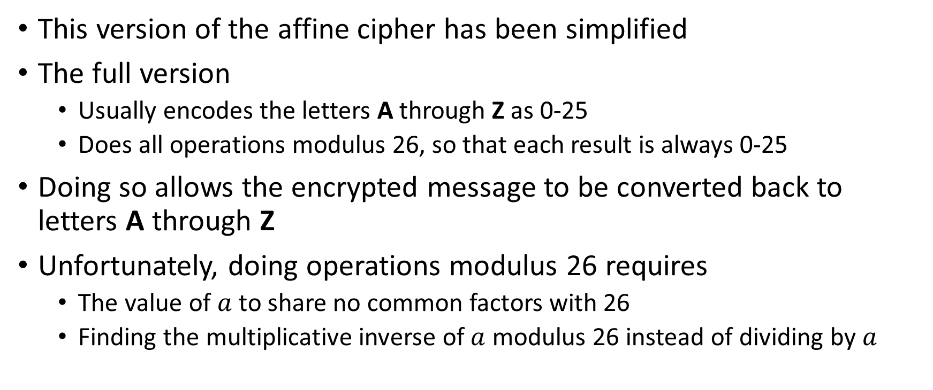
A few finer points
This version of the affine cipher has been simplified
The full version
  Usually encodes the letters A through Z as 0-25
  Does all operations modulus 26, so that each result is always 0-25
Doing so allows the encrypted message to be converted back to letters A through Z
Unfortunately, doing operations modulus 26 requires
  The value of $a$ to share no common factors with 26
  Finding the multiplicative inverse of $a$ modulus 26 instead of dividing by $a$

