Slide 1
Algorithms and Algorithmic Thinking

Slide 2

What is an Algorithm

Slide 3
Algorithm
An algorithm is a description of a process of doing something, for completing some task, for calculating a result.
Examples:
A recipe for a cake
The steps in completing long division
Directions for driving from one place to another
The steps in an experiment in chemistry
Directions for a home covid test
Directions for writing a college essay

Slide 4
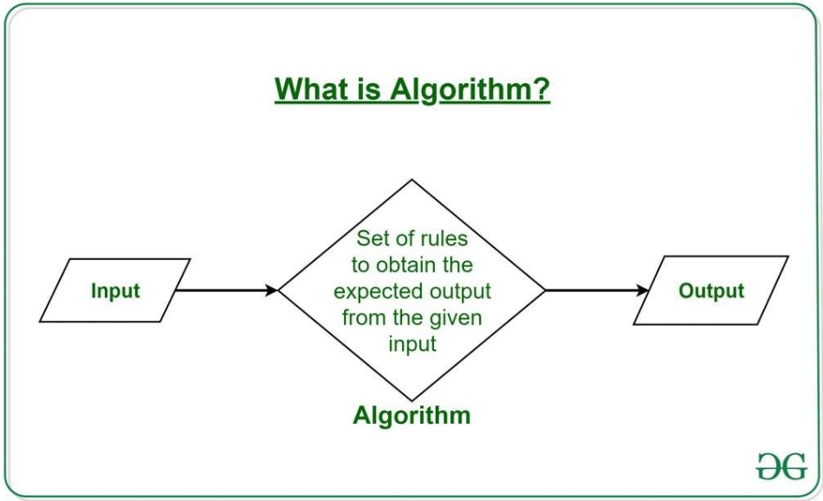
Components
Typically, an algorithm includes
Data used by the algorithm
  The data to be manipulated (the input)
  The data that will result (the output)
A description of the algorithm’s steps

Slide 5
Cake Recipe Example
Data for cake (alias: ingredients)
2 sticks unsalted butter, at room temperature, plus more for the pans
3 cups all-purpose flour, plus more for the pans
1 tablespoon baking powder
1/2 teaspoon salt
1 1/4 cups sugar
4 large eggs, at room temperature
1 tablespoon vanilla extract
1 1/4 cups whole milk (or 3/4 cup heavy cream mixed with 1/2 cup water)
[From: https://www.foodnetwork.com/recipes/food-network-kitchen/basic-vanilla-cake-recipe-2043654]
Directions: (alias: steps)
Preheat the oven to 350 degrees F.
Butter two 9-inch-round cake pans and line the bottoms with parchment paper; butter the parchment and dust the pans with flour, tapping out the excess.
Whisk 3 cups flour, the baking powder and salt in a bowl until combined.
Beat 2 sticks butter and the sugar in a large bowl with a mixer on medium-high speed until light and fluffy, about 3 minutes.
Reduce the mixer speed to medium; beat in the eggs, one at a time, scraping down the bowl as needed. Beat in the vanilla. (The mixture may look separated at this point.)
Beat in the flour mixture in 3 batches, alternating with the milk, beginning and ending with flour, until just smooth.
Divide the batter between the prepared pans.
Bake until the cakes are lightly golden on top and a toothpick inserted into the middle comes out clean, 30 to 35 minutes.
Transfer to racks and let cool 10 minutes, then run a knife around the edge of the pans and turn the cakes out onto the racks to cool completely.
Remove the parchment. Trim the tops of the cakes with a long serrated knife to make them level, if desired.

Slide 6
Steps in Long Division
Data (input)
  Numbers for be divided (dividend and divisor_
  Results (quotient and remainder)
Steps
  Step 1: Take the first digit of the dividend from the left. Check if this digit is greater than or equal to the divisor.
  Step 2: Then divide it by the divisor and write the answer on top as the quotient.
  Step 3: Subtract the result from the digit and write the difference below.
  Step 4: Bring down the next digit of the dividend (if present).
  Step 5: Repeat the same process.
[from https://www.cuemath.com/numbers/long-division/]

Slide 7
Algorithm for writing a college essay
Data
  Input -- ideas about your life experience and values
  Output - finished essay
  [Note that we are also using decomposition here in creating the components of this essay.]
Steps
Pick a topic
Prepare an outline or diagram of your ideas.
Write your thesis statement.
Write the body.
Write the introduction.
Write the conclusion.
Add the finishing touches.
Steps [From: https://www.fastweb.com/student-life/articles/essay-tips-7-tips-on-writing-an-effective-essay]

Slide 8
Description of Steps
Note that in each of these examples, there is an order to the steps.
  That is, there is a first step, a second step, etc.
The steps of an algorithm can have three forms.
  Sequence: complete the steps in order starting with step #1.
  Selection: there can be a choice based on some criteria
  Repetition: repeat a set of steps a specific number of times or until a criterion is reached

Slide 9
Selection
Selection involves make a choice:
  This is not an arbitrary choice, but one based on some criterion
  Note that in the last step of the cake recipe, is the instruction “Trim the tops of the cakes with a long serrated knife to make them level, if desired.”
    We have a choice to trim the tops or not
    The criterion in this case is our “desire”

