Slide 1
Abstraction

Slide 2


Abstraction resources
Focusing on the important aspects of a situation by ignoring unimportant details.
Good videos about abstraction

Slide 3
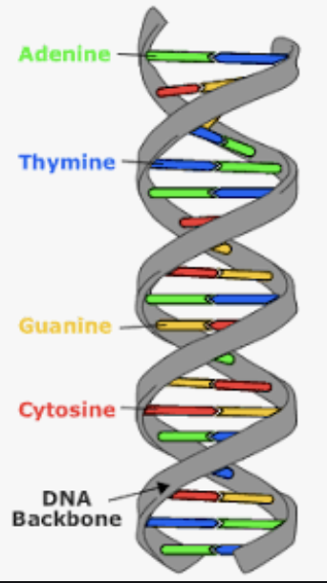
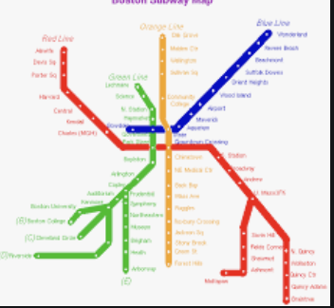

Abstraction - Model
https://www.pinterest.com/pin/153826143494808154/
An abstraction can be thought of as a model.
Examples:
  The double helix model of DNA
  A map of the subway system in Boston
  A curriculum map for a major
  A general description of how to do long division
  A political map
https://www.pinterest.com/pin/107030928614088159/
https://www.remc.org/21Things4Students/21/21-computational-thinking/q4-abstraction/

Slide 4
Key in Abstraction : deciding what is important
Note that abstraction involves focusing on the important aspects of a situation/problem/design
  And ignoring the unimportant details
But the aspect that are important or unimportant depend on the context
Example: Consider the problem of building a house
  What kind of information does a plumber need to know in building the house?
    The details of the where the sinks go, where the water lines enter the house, where the sewer lines leave the house are important.
    Also, know the size of the water pipes and sewer pipes are important details.
  What kinds of information can the plumber ignore?
    The location of all of the electrical outlets, the location and size of all of the other cabinets in the kitchen and bath, the number and size of bedrooms, etc.

Slide 5
Abstraction Example
What do you say if someone asks you “what did you do this weekend”?
  You don’t provide a minute-by-minute description or even the hour-by-hour detail.
  You might abstract to a day-by-day model: on Friday, I drove home after class, on Saturday, I went to my sister’s soccer game, and on Sunday, had lunch with my family and drove back to school.
  Alternatively, if a friend at school with whom you are doing a school project, you might report that on Friday, I went uptown with some friends, but I worked on the project all Saturday afternoon, and again Sunday afternoon and evening.
Note that, with either answer, you are ignoring a lot of details.
Also, note that the things that are important and not ignored depend on the context.

Slide 6
Exercises
Write a summary of the book War and Peace.
  This is a very long book. What are the important items that you should cover? What details can you ignore?
  What if this were for a history class in which the purpose is to set the story in its historical context?
  What if this summary was for an anthropology or psychology class where the purpose was to understand human nature?
If you are trying to students in a beginning biology class understand the differences among the various species?
  For example, what is an animal? Or what is a plant?
  To answer these questions, you might examine examples and look for things that they have in common. Then you would abstract from that.

Slide 7
Types of abstraction
Procedural abstraction
Data abstraction
Note that the process of abstraction, may (often) involves decomposition or pattern recognition.
  For example, in writing a summary of the novel War and Peace, you may need to decompose the details into categories - such as characters, settings, time sequence, etc.
  To answer the question of how to define the term abstraction animal, you may want to look at examples to see what characteristics they have in common.
    That is, what patterns do you see?

Slide 8
Procedural abstraction
Abstracting away the details of a process for doing something
Example from mathematics:
  Here are some specific (not abstracted) computations:
    (2 + 3) x 5
    (7 + 10) x 100
  And here is a procedural abstraction for these: (a + b) x c
Example from baking:
  To bake a cake, you put the ingredients into a bowl, mix them thoroughly, pour this mixture into a baking pan, bake it for the required time.
  Note that this is an abstraction of the process that applies to many different types of cakes.
  The details of what ingredients, how much of each ingredient, and the time to bake are not given in this abstraction.

Slide 9
Data abstraction
Simplifying a collection of data in a way that captures the essence of the data without the details
Example:
  A school may keep a large number of attributes about each student in the school (name, address, grades, test scores, etc.) We abstract this as the student record.
  When discussing the weather for a particular day, the detail includes the high and low temperatures, the relative humidity, wind speed and direction. We refer to this collection of data as the abstraction today’s weather.
  Boston metro

