Slide 1
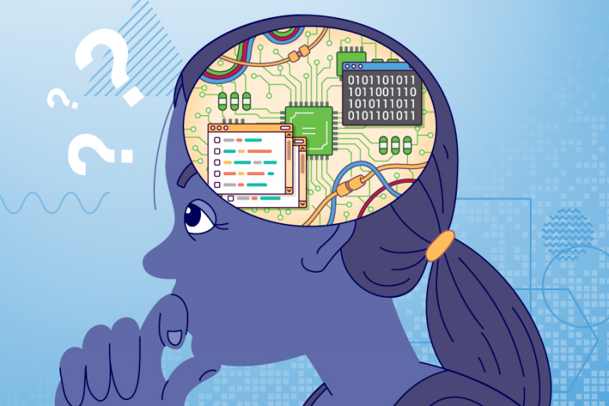
Computer Science and Computational Thinking
Introduction

Slide 2
What is Computer Science
CS ≠ programming or coding
Computer science is no more about computers than astronomy is about telescopes.
Edsger Dijkstra
[from https://en.wikipedia.org/wiki/Computer_science#Epistemology_of_computer_science ]
Computer science is:
Computer science, at its core, is about storing, accessing, transforming, transmitting, and interacting with information.
[Thomas Corman in the book What Are the Arts and Sciences: A Guide For the Curious ]

Slide 3
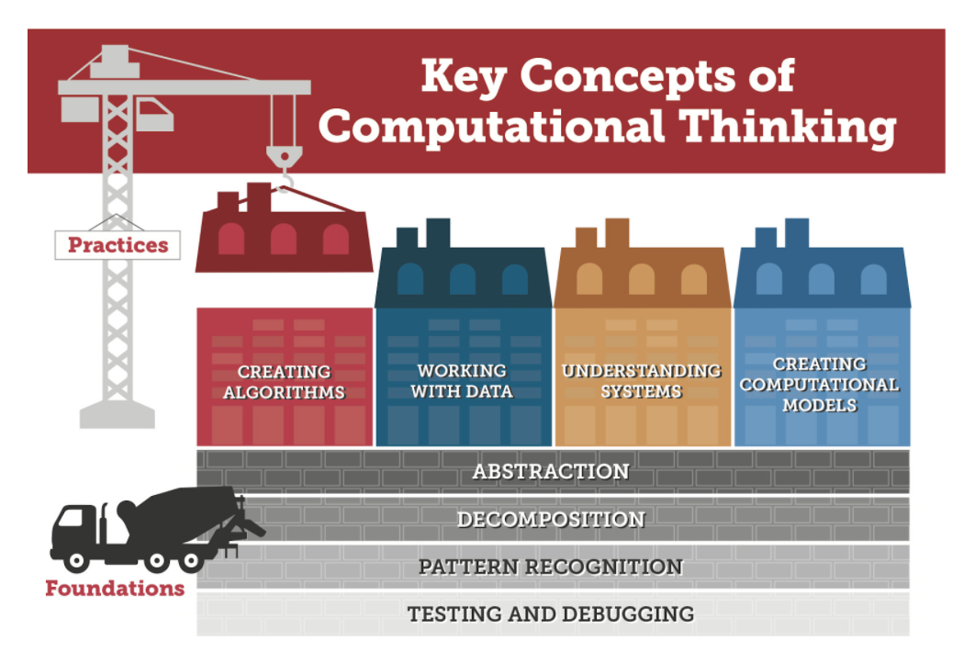
What is computational thinking?
Computational thinking refers to the thought processes involved in expressing solutions as computational steps or algorithms that can be carried out by a computer.
(Cuny, Snyder, & Wing, 2010; Aho, 2011; Lee, 2016).
From Digital Promise: https://digitalpromise.org/initiative/computational-thinking/computational-thinking-for-next-generation-science/what-is-computational-thinking/

Slide 4
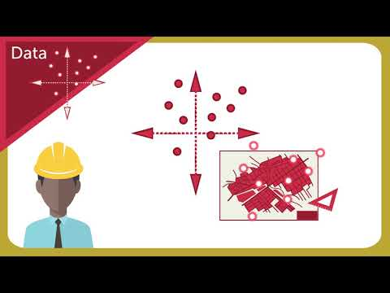
Computational Thinking for a Computational World

Slide 5
Operational Definition of Computational Thinking
Computational thinking (CT) is a problem-solving process that includes (but is not limited to) the following characteristics:
Formulating problems in a way that enables us to use a computer and other tools to help solve them.
Logically organizing and analyzing data
Representing data through abstractions such as models and simulations
Automating solutions through algorithmic thinking (a series of ordered steps)
Identifying, analyzing, and implementing possible solutions with the goal of achieving the most efficient and effective combination of steps and resources
Generalizing and transferring this problem solving process to a wide variety of problems
[from: https://cdn.iste.org/www-root/ct-documents/computational-thinking-operational-definition-flyer.pdf ]

Slide 6
Skills are supported and enhanced by a number of dispositions or attitudes that are essential dimensions of CT.
Confidence in dealing with complexity
Persistence in working with difficult problems
Tolerance for ambiguity
The ability to deal with open ended problems
The ability to communicate and work with others to achieve a common goal or solution
[from: https://cdn.iste.org/www-root/ct-documents/computational-thinking-operational-definition-flyer.pdf ]

Slide 7
Differences Between Computational Thinking & Computer Science
“It is important to note that computational thinking overlaps, and yet is distinct from, computer science (the study of computers and algorithmic processes, including their principles, hardware and software designs, and impact on society) and coding (the practice of developing a set of instructions that a computer can understand and execute).”
“About Computational Thinking.” Digital Promise, 24 Mar. 2022, https://digitalpromise.org/initiative/computational-thinking/ct-pathways-toolkit/about-computational-thinking/

Slide 8
Concepts at the intersection of computer science and computational thinking
Decomposition
Pattern recognition
Abstraction
Algorithm Design
Testing and debugging
First 4 from Kristen Thorson Early Learning Strategies for Developing Computational Thinking Skills, Mar 18, 2018, https://www.gettingsmart.com/2018/03/18/early-learning-strategies-for-developing-computational-thinking-skills/
Testing and debugging added by K12 Computer Science https://k12cs.org/computational-thinking/

Slide 9
Decomposition
Breaking a problem down into its constituent parts.
The power of computational thinking starts with decomposition, which is the process of breaking down complex problems into smaller, more manageable parts. With decomposition, problems that seem overwhelming at first become much more manageable...Problems we encounter both in the course of student learning and throughout our daily lives are ultimately comprised of smaller problems we can more easily address. This process of breaking down problems enables us to analyze the different aspects of them, ground our thinking, and guide ourselves to an end point.
[Anna McVeigh-Murphy, The One About Decomposition in Computational Thinking, September 25, 2019, https://equip.learning.com/decomposition-computational-thinking/
“If you can’t solve a problem, then there is an easier problem you can solve: find it.”
George Pólya

Slide 10
Examples of Decomposition in Everyday Life
Decomposition is something we inherently do in our daily lives, even if we don’t realize it.
If you hosted a holiday dinner, you used decomposition to select the menu, enlist support from others in the kitchen, task people with what to bring, determine the process by which to cook the different elements, and set the time for the event.
If you went to the grocery store for said holiday dinner you used decomposition to build your grocery list, guide the direction you took as you meandered the aisles, the route you followed to and from the store, and the vehicle in which you drove.
If you’ve implemented a new program or initiative at your school, you used decomposition to build your strategic plan, which included the program’s vision, strategy for gaining buy-in, annual goals, and everything else involved.
[from https://equip.learning.com/decomposition-computational-thinking/ ]

Slide 11
Examples of Decomposition in Curriculum
English Language Arts: Students analyze themes in a text by first answering: Who is the protagonist and antagonist? Where is the setting? What is the conflict? What is the resolution?
Mathematics: Students find the area of different shapes by decomposing them into triangles.
Science: Students research the different organs in order to understand how the human body digests food.
Social Studies: Students explore a different culture by studying the traditions, history, and norms that comprise it.
Languages: Students learn about sentence structure in a foreign language by breaking it down into different parts like subject, verb, and object.
Arts: Students work to build the set for a play by reviewing the scenes to determine their setting and prop needs.
[from https://equip.learning.com/decomposition-computational-thinking/ ]

Slide 12
Pattern Recognition in CS and CT
Specifically, with computational thinking, pattern recognition occurs as people study the different decomposed problems… Through analysis, students recognize patterns or connections among the different pieces of the larger problem. These patterns can be both shared similarities and shared differences. This concept is essential to building understanding amid dense information and goes well beyond recognizing patterns amongst sequences of numbers, characters, or symbols.
[from Anna McVeigh-Murphy, The One About Pattern Recognition in Computational Thinking, November 12, 2019, https://equip.learning.com/pattern-recognition-computational-thinking/ ]
pattern recognition, in computer science, the imposition of identity on input data, such as speech, images, or a stream of text, by the recognition and delineation of patterns it contains and their relationships. Stages in pattern recognition may involve measurement of the object to identify distinguishing attributes, extraction of features for the defining attributes, and comparison with known patterns to determine a match or mismatch.
[From: https://www.britannica.com/technology/pattern-recognition-computer-science ]

Slide 13
Examples of Pattern Recognition in Everyday Life
Pattern recognition is the foundation of our knowledge. As infants, we used patterns to make sense of the world around us, to begin to respond verbally and grow our language skills, and to develop behavioral responses and cultivate connections in this world.
Beyond this, pattern recognition also occurs when scientists are trying to identify the cause of a disease outbreak by looking for similarities in the different cases to determine the source of the outbreak.
Additionally, when Netflix recommends shows based on your interests or a chat bot pesters you on a website, the technology (Artificial Intelligence and Machine Learning) rely on pattern recognition.
[from Anna McVeigh-Murphy, The One About Pattern Recognition in Computational Thinking, November 12, 2019,
https://equip.learning.com/pattern-recognition-computational-thinking/ ]

Slide 14
Examples of Pattern Recognition in Curriculum
English Language Arts: Students begin to define sonnets based on similarities in separate examples.
Mathematics: Students recognize the specific formulas used to calculate slopes and intercepts.
Science: Students classify animals based on their characteristics and articulate common characteristics for the groupings.
Social Studies: Students identify the potential impact different economic trends reap by looking at data.
Languages: Students group different words in a foreign language by looking at their roots to build a better understanding of vocabulary.
Arts: Students categorize paintings based on commonalities between artists’ aesthetics and detail key characteristics that each grouping presents.
[From Anna McVeigh-Murphy, The One About Pattern Recognition in Computational Thinking, November 12, 2019,
https://equip.learning.com/pattern-recognition-computational-thinking/ ]

Slide 15
Abstraction
Abstraction is the process of filtering out – ignoring - the characteristics of patterns that we don't need in order to concentrate on those that we do. It is also the filtering out of specific details. From this we create a representation (idea) of what we are trying to solve.
[From https://www.bbc.co.uk/bitesize/guides/zttrcdm/revision/1 ]
Abstraction in computational thinking enables us to navigate complexity and find relevance and clarity at scale. … This process occurs through filtering out the extraneous and irrelevant in order to identify what’s most important and connects each decomposed problem… Abstraction is actually similar to the selective filtering function in our brains that gates the neural signals with which we are constantly bombarded so we can make sense of our world and focus on what’s essential to us.
[From: Anna McVeigh-Murphy, The One About Abstraction in Computational Thinking, January 8, 2020,
https://equip.learning.com/abstraction-computational-thinking/]

Slide 16
Examples of Abstraction in Everyday Life
Another way to think about abstraction is in the context of those big concepts that inform how we think about the world like Newton’s Laws of Motion, the Law of Supply and Demand, or the Pythagorean Theorem.
All of these required the people behind them to think about big, broad, and complex concepts; to break down the problem and to experiment; and to find patterns amongst the experimentations; and to eventually abstract this concrete knowledge to package it into these sterile statements that shelter us from the complexity and difficulty waded through to arrive at this law.
Educators use abstraction when looking at vast sets of student data to focus on the most relevant numbers and trends. And educators also use it when helping a student complete an assignment. There may be kids running around the classroom or making loud noises, but they can tune that out to focus on what the kid in need is asking – until of course it reaches an apex level of rambunctiousness and an intervention must be had.
[From: Anna McVeigh-Murphy, The One About Abstraction in Computational Thinking, January 8, 2020,
https://equip.learning.com/abstraction-computational-thinking/]

Slide 17
Examples of Abstraction in Curriculum
English Language Arts Students summarize a novel into a book review.
Mathematics: Students conduct a survey of peers and analyze the data to note the key findings, create visualizations, present the findings.
Science: Students develop laws and theorems by looking at similar formulas and equations.
Social Studies: Students coalesce the most important details shared in articles about a specific current event and write a brief about the event.
Languages: Students create a personal guide that dictates when to use the formal and informal ‘you’ in Spanish class or the two ‘to know’ verbs in French, which, mind you, always confounded me.
Arts: Students generalize chord progressions for common musical genres into a set of general principles they can communicate.
[From: Anna McVeigh-Murphy, The One About Abstraction in Computational Thinking, January 8, 2020, https://equip.learning.com/abstraction-computational-thinking/]

Slide 18
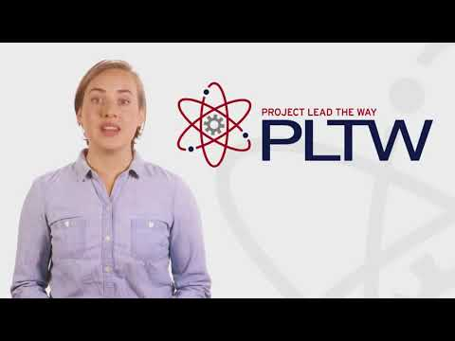
Algorithmic Thinking
Algorithmic thinking is the use of algorithms, or step-by-step sets of instructions, to complete a task...Knowing what an algorithm is is very different from thinking algorithmically. It’s the difference between memorizing a formula and constructing your own. … it’s understanding conditional statements and loops and using logic to problem-solve and create procedural writing.
[From Tech-based Teaching, If Curious, Then Learn: A Brief Intro to Algorithmic Thinking, https://medium.com/tech-based-teaching/if-curious-then-learn-a-brief-intro-to-algorithmic-thinking-ba683bf44994

Slide 19
Algorithmic Thinking
An algorithm is a process or formula for calculating answers, sorting data, and automating tasks; and algorithmic thinking is the process for developing an algorithm.
With algorithmic thinking, students endeavor to construct a step-by-step process for solving a problem and like problems so that the work is replicable by humans or computers.
Algorithmic thinking is a derivative of computer science and the process to develop code and program applications. This approach automates the problem-solving process by creating a series of systematic, logical steps that intake a defined set of inputs and produce a defined set of outputs based on these.
In other words, algorithmic thinking is not solving for a specific answer; instead, it solves how to build a sequential, complete, and replicable process that has an end point – an algorithm. Designing an algorithm helps students to both communicate and interpret clear instructions for a predictable, reliable output. This is the crux of computational thinking.
[from Anna McVeigh-Murphy, The One About Algorithmic Thinking in Computational Thinking, February 26, 2020 https://equip.learning.com/algorithmic-thinking-computational-thinking/]

Slide 20
Algorithm
An algorithm is a precisely defined process for solving a problem, usually in a way that can be easily automated. Algorithmic thinking, or computational thinking, refers to thinking about these processes for solving problems. In schools, the study of algorithms includes learning about the ways that information and processes can be represented systematically, the common building blocks of algorithms, such as loops and conditional statements, and patterns in the design of algorithms. Many of the problem solving strategies that students learn in mathematics classes, such as ‘Guess, Check and Improve' or ‘Try a simpler problem' are similar to algorithm design strategies.
Greg Breese
[From Teacher magazine: https://www.teachermagazine.com/au_en/articles/teacher-qa-algorithmic-thinking ]

Slide 21
Algorithmic Thinking
The part of the Computational Thinking skill set that is very distinctively what computer science is about is algorithmic thinking.
Some problems are one-offs. You solve them, apply the solution and move on. Algorithmic thinking needs to kick in when similar problems have to be solved over and over again. You don't want to have to think it through anew every time. You want a solution that works every time.
Algorithmic thinking is important for many "strategy" board games. Ideally you want to come up with a strategy that is guaranteed to win, or at least never lose. All such a strategy is is a set of rules that tell you what to do at each step without thinking: what computer scientists call an algorithm. If you can create such a set of rules, not only could it be the basis of you playing well, but also of a computer program that plays well. Even your granny or kid brother should be able to play a perfect game by following your rules!
Algorithmic thinking is the ability to think in terms of such algorithms as a way of solving problems. It is a core skill people develop when they learn to write their own computer programs.
[From: CS4FN Computer Science for Fun: http://www.cs4fn.org/computationalthinking/algorithmicthinking.php

Slide 22
Examples of Algorithms in Everyday Life
And like computational thinking and its other elements we’ve discussed, algorithms are something we experience regularly in our lives.
If you’re an amateur chef or a frozen meal aficionado, you follow recipes and directions for preparing food, and that’s an algorithm.
When you’re feeling groovy and bust out in a dance routine – maybe the Cha Cha Slide, the Macarena, or Flossing – you are also following a routine that emulates an algorithm and simultaneously being really cool.
Democratic National Convention 90S GIF by Election 2016 - Find & Share on GIPHY
Outlining a process for checking out books in a school library or instructions for cleaning up at the end of the day is developing an algorithm and letting your inner computer scientist shine.
[from Anna McVeigh-Murphy, The One About Algorithmic Thinking in Computational Thinking, February 26, 2020 https://equip.learning.com/algorithmic-thinking-computational-thinking/]

Slide 23
Testing and Debugging
Debugging and Evaluation – testing and refining a potential solution, and ensuring it’s the best fit for the problem.
[from CSforCA: COMPUTER SCIENCE SKILLS: COMPUTATIONAL THINKING EXPLAINED, January 5, 2021 https://csforca.org/computer-science-skills-computational-thinking-explained/ ]
Testing and refinement is the deliberate and iterative process of improving a computational artifact. This process includes debugging (identifying and fixing errors) and comparing actual outcomes to intended outcomes. Students also respond to the changing needs and expectations of end users and improve the performance, reliability, usability, and accessibility of artifacts.
[From: Report of the K–12 Computer Science Framework Steering Committee https://k12cs.org/wp-content/uploads/2016/09/K%E2%80%9312-Computer-Science-Framework.pdf ]

Slide 24
Learning Outcomes for Testing and Refining Computational Artifacts
Systematically test computational artifacts by considering all scenarios and using test cases.
Identify and fix errors using a systematic process
Evaluate and refine a computational artifact multiple times to enhance its performance, reliability, usability, and accessibility
[From: Report of the K–12 Computer Science Framework Steering Committee https://k12cs.org/wp-content/uploads/2016/09/K%E2%80%9312-Computer-Science-Framework.pdf ]

Slide 25
Examples of Algorithms in Curriculum
English Language Arts: Students map a flow chart that details directions for determining whether to use a colon or dash in a sentence.
Mathematics: In a word problem, students develop a step-by-step process for how they answered a question that can then be applied to similar problems.
Science: Students articulate how to classify elements in the periodic table.
Social Studies: Students describe a sequence of smaller events in history that precipitated a much larger event.
Languages: Students apply new vocabulary and practice speaking skills to direct another student to perform a task, whether it’s ordering coffee at a café or navigating from one point in a classroom to another.
Arts: Students create instructions for drawing a picture that another student then has to use to recreate the image.
[from Anna McVeigh-Murphy, The One About Algorithmic Thinking in Computational Thinking, February 26, 2020 https://equip.learning.com/algorithmic-thinking-computational-thinking/]

Slide 26
Examples of review and testing from everyday life
The task of a book editor involves very detailed review of manuscripts
Engineering plans for a new building are reviewed extensively throughout the process of design and construction.
For a faculty member, publishing in a research journal often requires a long review process before publication.

Slide 27
Examples of review and testing in curriculum
In an English class, for an assignment of writing an essay, students submit a paper draft. These drafts are reviewed by classmates
Mathematics: in an assignment to learn long division, students are permitted to check their work with a calculator.
Science: in a Chemistry class, students perform a wet lab experiment and verify their results analytically.

